Slide 1

8th Grade Math: Pre-Algebra
Unit 4, Lesson 10 Applying Multiple Laws of Exponents – Part 1 Volume 1, pg. 165

Slide 2


Benchmark
MA.8.AR.1.1
Apply the Laws of Exponents to generate equivalent algebraic expressions, limited to integer exponents and monomial bases.
volume 1, pg. 165

Slide 3
Integrated Mathematical Thinking and Reasoning Standards
MA.K12.MTR.1.1 Actively participate in effortful learning both individually and collectively.
MA.K12.MTR.3.1 Complete tasks with mathematical fluency.
MA.K12.MTR.4.1 Engage in discussions that reflect on the mathematical thinking of self and others.
volume 1, pg. 165

Slide 4

Learning Target
I can write an equivalent algebraic expression by applying multiple laws of exponents.
volume 1, pg. 165

Slide 5

Warm-Up
volume 1, pg. 166

Slide 6
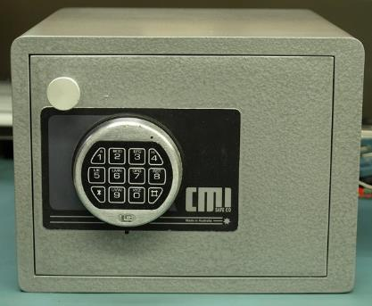
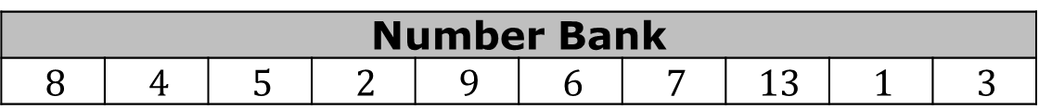
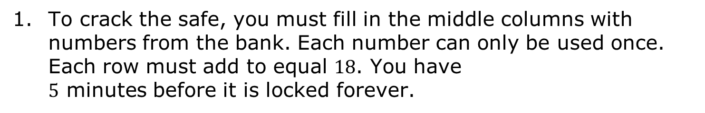
4.10.1 Warm-Up: Crack the Safe
To crack the safe, you must fill in the middle columns with numbers from the bank. Each number can only be used once. Each row must add to equal $18$. You have $5$ minutes before it is locked forever.
Number Bank
$$8$$ | $$4$$ | $$5$$ | $$2$$ | $$9$$ | $$6$$ | $$7$$ | $$13$$ | $$1$$ | $$3$$
Code |  |  | Row Total
3 |  |  | 18
6 |  |  | 18
2 |  |  | 18
9 |  |  | 18
12 |  |  | 18
volume 1, pg. 166
Notes:
Video Link: https://algebranation.wistia.com/medias/fi4fidi5y8

Slide 7

Guided Practice
volume 1, pg. 166

Slide 8

4.10.2 Guided Practice: Applying Multiple Laws of Exponents to Algebraic Expressions
The laws of exponents are included in the bank below for you to reference as you complete the following problems.
Laws of Exponents
Product of Powers | Quotient of Powers | Power of a Power
Power of a Product | Power of a Quotient | Negative Exponent
Identity Exponent | Zero Exponent
volume 1, pg. 166

Slide 9
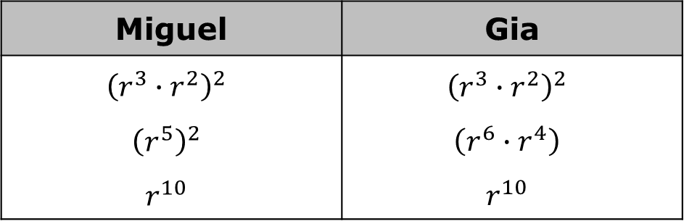

Miguel and Gia generated the same expression equivalent to ${\left(r^{3}·r^{2}\right)}^{2}$. They both applied laws of exponents, but in different ways. Their work is shown.
For each student, identify which laws of exponents they applied and in what order.
Miguel | Gia
$${\left(r^{3}∙r^{2}\right)}^{2}$$ $${\left(r^{5}\right)}^{2}$$ $$r^{10}$$ | $${\left(r^{3}∙r^{2}\right)}^{2}$$ $$\left(r^{6}∙r^{4}\right)$$ $$r^{10}$$
Order of Laws Applied | Miguel | Gia
First
Second
volume 1, pg. 166

Slide 10
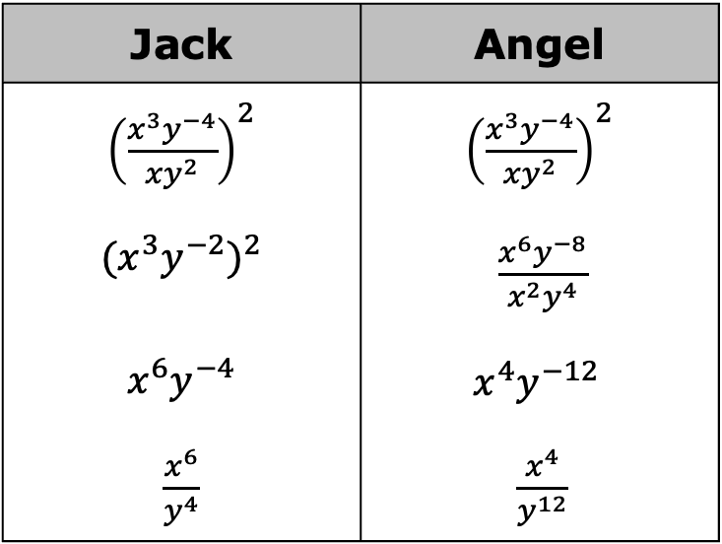
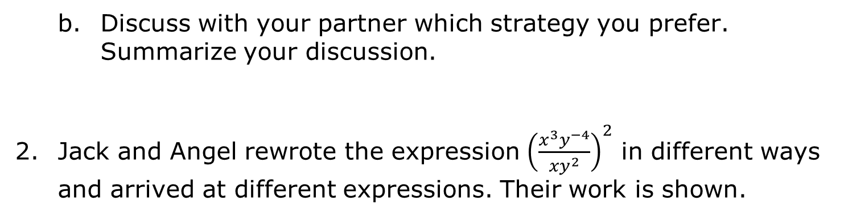
Discuss with your partner which strategy you prefer. Summarize your discussion.
Jack and Angel rewrote the expression ${\left(\frac{x^{3}y^{−4}}{xy^{2}}\right)}^{2}$ in different ways and arrived at different expressions. Their work is shown.
Jack | Angel
${\left(\frac{x^{3}y^{−4}}{xy^{2}}\right)}^{2}$ $${({x^{3}y}^{−2})}^{2}$$ $$x^{6}y^{−4}$$ $\frac{x^{6}}{y^{4}}$ | ${\left(\frac{x^{3}y^{−4}}{xy^{2}}\right)}^{2}$ $\frac{x^{6}y^{−8}}{{x^{2}y}^{4}}$ $$x^{4}y^{−12}$$ $\frac{x^{4}}{y^{12}}$
volume 1, pg. 167

Slide 11

Even though one of the student’s resulting expressions is not equivalent to ${\left(\frac{x^{3}y^{−4}}{xy^{2}}\right)}^{2}$, identify which laws of exponents each student applied and in what order.
Which student generated an expression that is not equivalent to ${\left(\frac{x^{3}y^{−4}}{xy^{2}}\right)}^{2}$?
Order of Laws Applied | Jack | Angel
First
Second
Third
volume 1, pg. 167

Slide 12
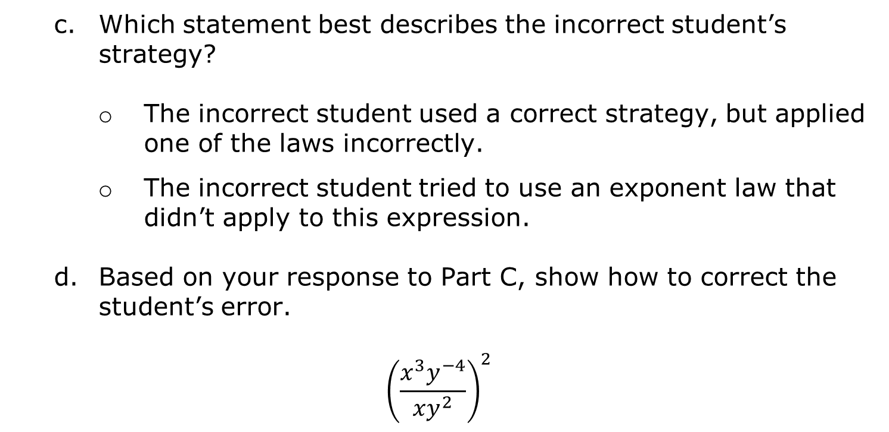
Which statement best describes the incorrect student’s strategy?
The incorrect student used a correct strategy, but applied one of the laws incorrectly.
The incorrect student tried to use an exponent law that didn’t apply to this expression.
Based on your response to Part C, show how to correct the student’s error.
$${\left(\frac{x^{3}y^{−4}}{xy^{2}}\right)}^{2}$$
volume 1, pg. 167

Slide 13

Try It
volume 1, pg. 168

Slide 14
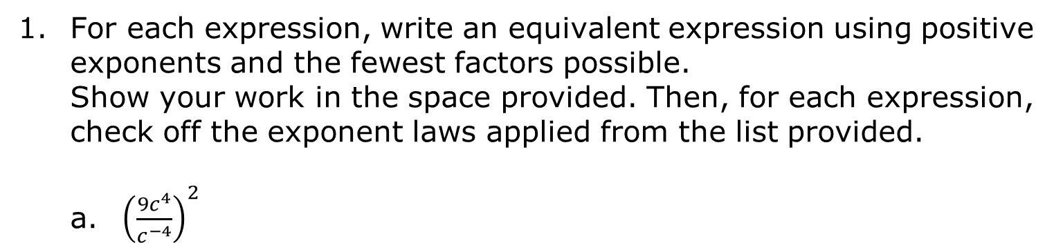
4.10.3 Try It: Applying Multiple Laws of Exponents to Algebraic Expressions
For each expression, write an equivalent expression using positive exponents and the fewest factors possible. Show your work in the space provided. Then, for each expression, check off the exponent laws applied from the list provided.
a. ${\left(\frac{{9c}^{4}}{c^{−4}}\right)}^{2}$
Exponent Laws Applied
identity exponent negative exponent power of a power power of a product power of a quotient product of powers quotient of powers zero exponent
volume 1, pg. 168

Slide 15
${\left(d^{0}·d^{5}\right)}^{−2}$
Exponent Laws Applied
identity exponent negative exponent power of a power power of a product power of a quotient product of powers quotient of powers zero exponent
volume 1, pg. 168

Slide 16

Activity
volume 1, pg. 168

Slide 17

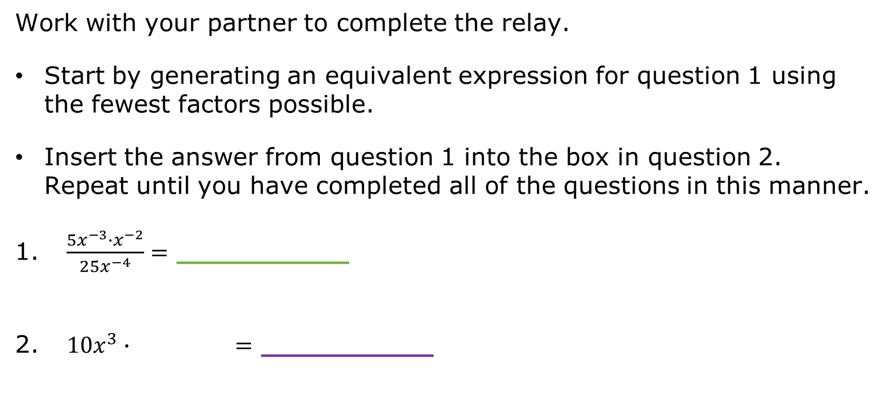
4.10.4 Activity: Exponent Laws Relay
Work with your partner to complete the relay.
Start by generating an equivalent expression for question 1 using the fewest factors possible.
Insert the answer from question 1 into the box in question 2. Repeat until you have completed all of the questions in this manner.
$\frac{{5x}^{−3}∙x^{−2}}{{25x}^{−4}}=$ __________
${10x}^{3}∙ =$ __________
volume 1, pg. 168

Slide 18
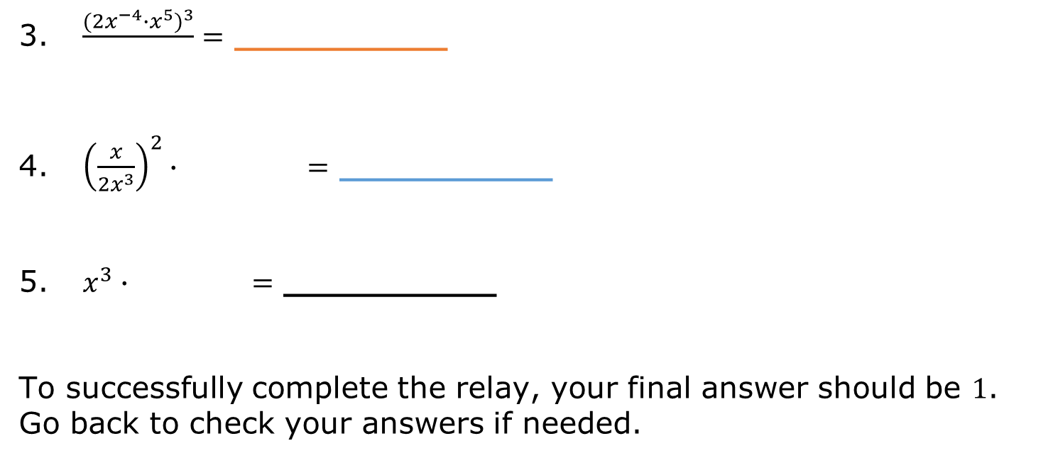
$\frac{{({2x}^{−4}∙x^{5})}^{3}}{ }=$ __________
${\left(\frac{x}{{2x}^{3}}\right)}^{2}∙ =$ __________
$x^{3}∙ =$ __________
To successfully complete the relay, your final answer should be $1$. Go back to check your answers if needed.
volume 1, pg. 168

Slide 19

Your Turn
volume 1, pg. 169

Slide 20
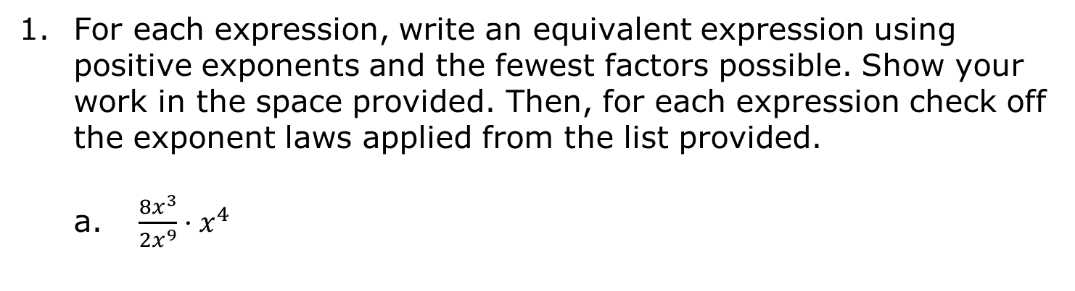
4.10.5 Your Turn!
For each expression, write an equivalent expression using positive exponents and the fewest factors possible. Show your work in the space provided. Then, for each expression check off the exponent laws applied from the list provided.
$\frac{{8x}^{3}}{{2x}^{9}}·x^{4}$
Exponent Laws Applied
identity exponent negative exponent power of a power power of a product power of a quotient product of powers quotient of powers zero exponent
volume 1, pg. 169

Slide 21
$\left(\frac{p^{0}·q^{−2}}{{\left(p^{−3}·q\right)}^{2}}\right)$
Exponent Laws Applied
identity exponent negative exponent power of a power power of a product power of a quotient product of powers quotient of powers zero exponent
volume 1, pg. 169

Slide 22

Wrap-Up
volume 1, pg. 169

Slide 23
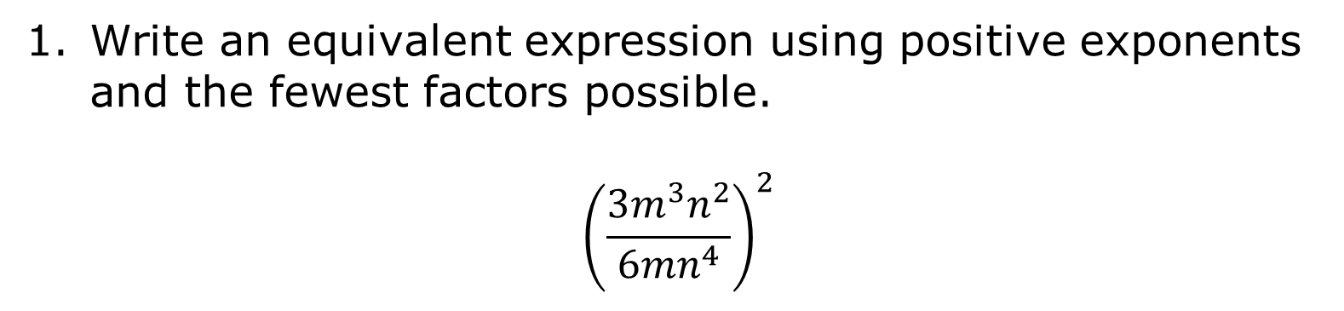
4.10.6 Wrap-Up: Ticket Out the Door
Write an equivalent expression using positive exponents and the fewest factors possible.
$${\left(\frac{{3m}^{3}n^{2}}{{6mn}^{4}}\right)}^{2}$$
volume 1, pg. 169

